Slide 1

Chapter 7
LPS, UPS and CRO
Basic Electronics, 2020-2021, Even Semester

Slide 2
Agenda
Linear power supply
  Working, advantages and disadvantages
Uninterrupted Power Supply
  Types and their working
Cathode Ray Oscilloscope
  Working and applications
School of Electronics and Communication Engineering, 2020-2021 Even

Slide 3
Linear power supply
Definition: A power supply is an electrical device that supplies electric power to an electrical load
    The primary function of a power supply is to convert electric current from a source to the required voltage, current, and frequency to power the load. As a result, power supplies are sometimes referred to as electric power converters
School of Electronics and Communication Engineering, 2020-2021 Even

Slide 4
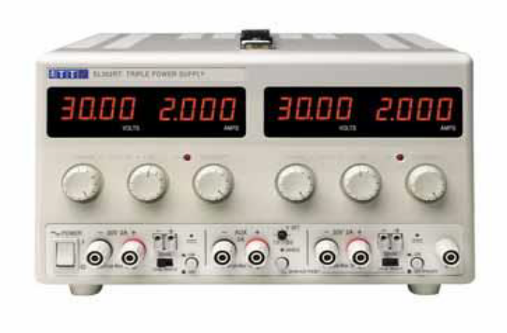
Linear Power supply (LPS)
  Definition: The term linear power supply implies that the power supply is regulated to provide the specified voltage at the output
    Linear regulated power supplies gain their name from the fact that they use linear, i.e. non-switching techniques to regulate the voltage output from the power supply
Typical variable linear power supply for bench laboratory use
School of Electronics and Communication Engineering, 2020-2021 Even

Slide 5
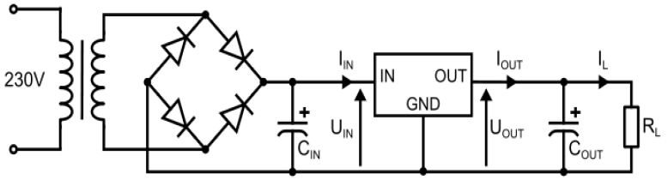
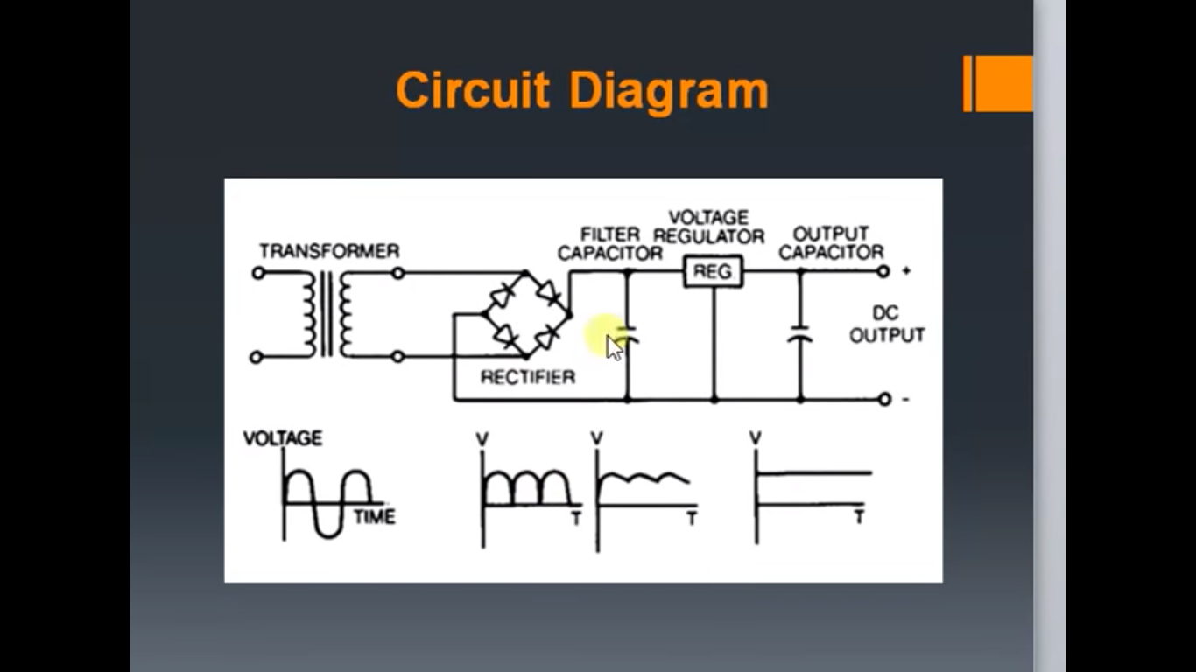
Linear Power supply (LPS)
78xx- Positive voltage regulators
79xx- negative voltage regulators
School of Electronics and Communication Engineering, 2020-2021 Even

Slide 6
Advantages and Disadvantages
Advantages
  Simple application
  Low cost
  Low noise/ripple
  Established technology
Disadvantages
  Limited flexibility
  Limited outputs
  Poor efficiency
  Large Size/Bulky
  Heat dissipation
School of Electronics and Communication Engineering, 2020-2021 Even

Slide 7
Some Examples
Some examples:
+5V logic and microprocessor circuits
+12V LED lighting, general electronics
±15V op amp circuits
0-30V bench test supply
+14.5V battery charger
School of Electronics and Communication Engineering, 2020-2021 Even

Slide 8
Uninterrupted Power supply (UPS)
Definition: An Uninterruptible Power Supply (UPS) is defined as a piece of electrical equipment which can be used as an immediate power source to the connected load when there is any failure in the main input power source.
School of Electronics and Communication Engineering, 2020-2021 Even

Slide 9
Types of UPS
UPS system is categorized into
  Off-line UPS
  On- line UPS
  Line interactive UPS
School of Electronics and Communication Engineering, 2020-2021 Even

Slide 10
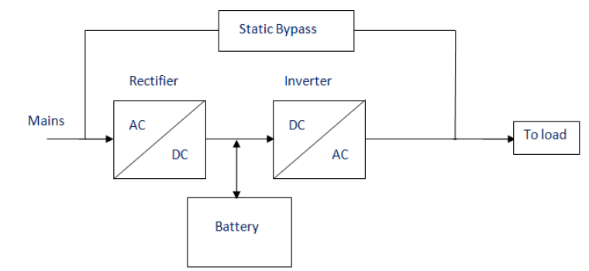
On- line UPS
School of Electronics and Communication Engineering, 2020-2021 Even

Slide 11
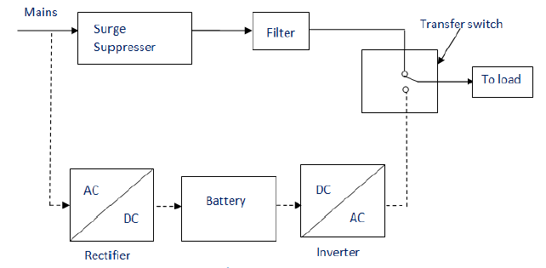
Off-line UPS- Static UPS
School of Electronics and Communication Engineering, 2020-2021 Even

Slide 12
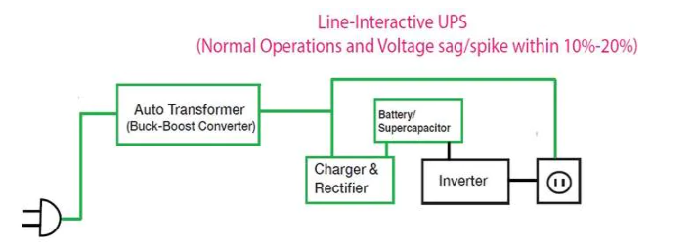
Line Interactive UPS
The line-interactive UPS has a similar design to the offline/standby, but with properties of an online/double conversion as well.
The line-interactive design can handle small under-voltages and over-voltages (about 20% from its standard voltage) by using a multi-tap variable voltage autotransformer or buck-boost converter.
Even during these small under/over-voltages, the battery is not being used and is still being charged until there is a big under/over-voltage.
School of Electronics and Communication Engineering, 2020-2021 Even

Slide 13
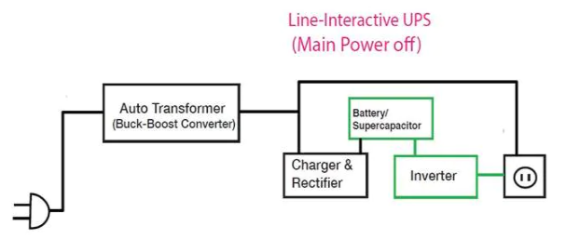
Line interactive UPS
School of Electronics and Communication Engineering, 2020-2021 Even

Slide 14
UPS Applications
Data Centers
Industries
Telecommunications
Hospitals
Banks and insurance
Some special projects (events)
School of Electronics and Communication Engineering, 2020-2021 Even

Slide 15
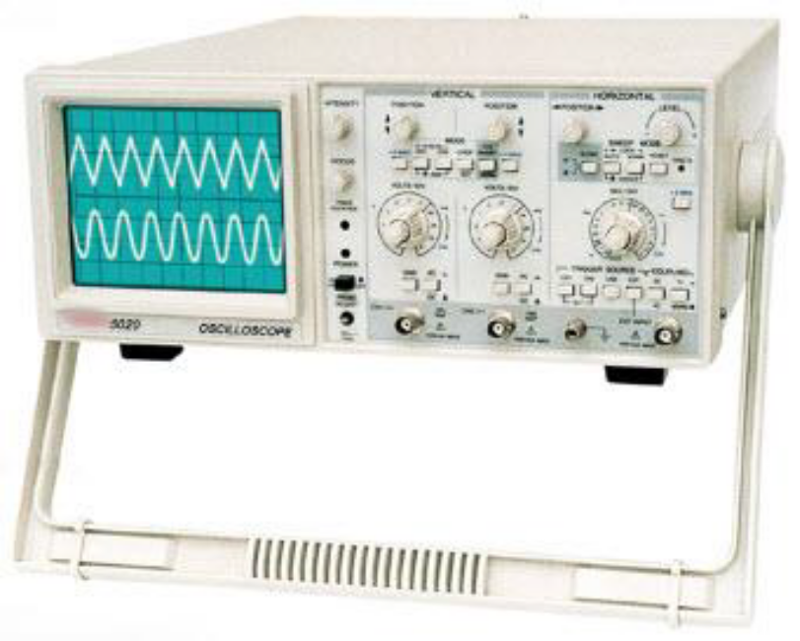
Cathode Ray Oscilloscope (CRO)
It is an electronic display device that converts electrical signal into a visual signals.
Displays a voltage waveform.
School of Electronics and Communication Engineering, 2020-2021 Even

Slide 16
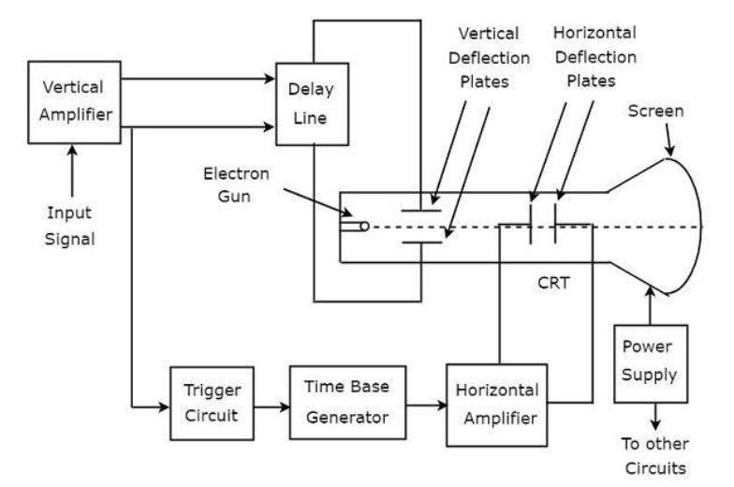
Block Diagram of CRO
School of Electronics and Communication Engineering, 2020-2021 Even

Slide 17
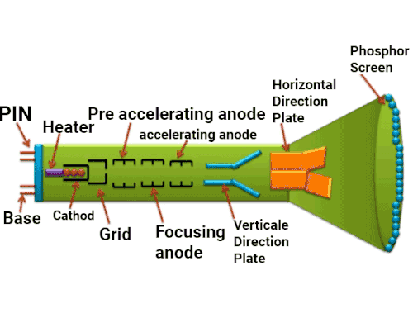
Block Diagram of CRO
School of Electronics and Communication Engineering, 2020-2021 Even

Slide 18
Block Diagram description
Vertical Amplifier − It amplifies the input signal, which is to be displayed on the screen of CRT.
Delay Line − It provides some amount of delay to the signal, which is obtained at the output of vertical amplifier. This delayed signal is then applied to vertical deflection plates of CRT.
Trigger Circuit − It produces a triggering signal in order to synchronize both horizontal and vertical deflections of electron beam.
Time base Generator − It produces a sawtooth signal, which is useful for horizontal deflection of electron beam.
Horizontal Amplifier − It amplifies the sawtooth signal and then connects it to the horizontal deflection plates of CRT.
Power supply − It produces both high and low voltages. The negative high voltage and positive low voltage are applied to CRT and other circuits respectively.
School of Electronics and Communication Engineering, 2020-2021 Even

Slide 19
Measurements by using CRO
We can do the following measurements by using CRO
  Measurement of Amplitude
  Measurement of Time Period
  Measurement of Frequency
School of Electronics and Communication Engineering, 2020-2021 Even

Slide 20
Measurement of Amplitude
CRO displays the voltage signal as a function of time on its screen.
The amplitude of that voltage signal is constant, but we can vary the number of divisions that cover the voltage signal in vertical direction by varying volt/division knob on the CRO panel.
Therefore, we will get the amplitude of the signal, which is present on the screen of CRO by using following formula.
A=j × nv
  Where,
  • A is the amplitude
  • j is the value of volt/division
  • nv is the number of divisions that cover the signal in vertical direction
School of Electronics and Communication Engineering, 2020-2021 Even

Slide 21
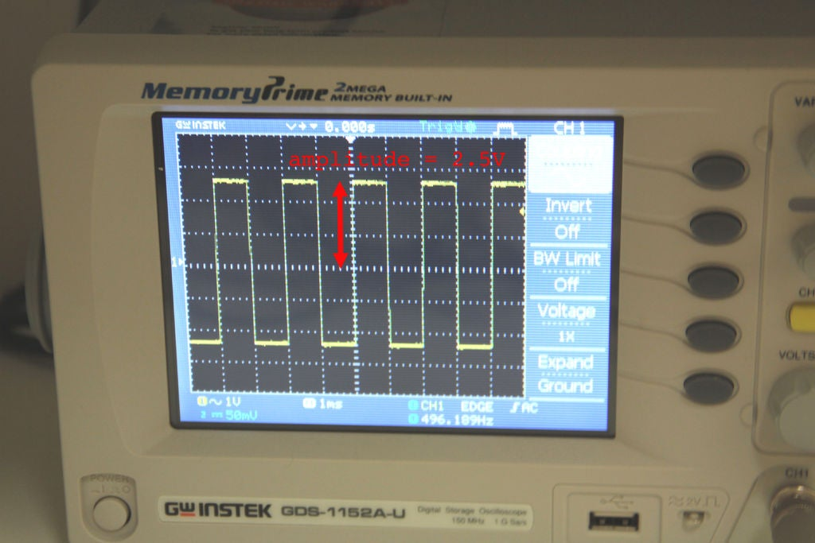
School of Electronics and Communication Engineering, 2020-2021 Even

Slide 22
Measurement of Time Period
The Time period of that periodic voltage signal is constant, but we can vary the number of divisions that cover one complete cycle of voltage signal in horizontal direction by varying time/division knob on the CRO panel.
Therefore, we will get the Time period of the signal, which is present on the screen of CRO by using following formula
T = k × nh
  Where,
  • T is the Time period
  • k is the value of time/division
  • n_{h} is the number of divisions that cover one complete cycle of the periodic signal in horizontal direction.
School of Electronics and Communication Engineering, 2020-2021 Even

Slide 23
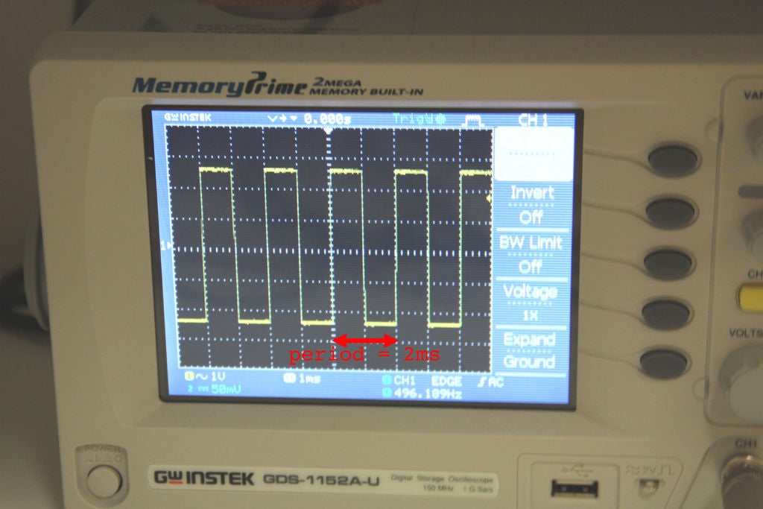
School of Electronics and Communication Engineering, 2020-2021 Even

Slide 24
Measurement of Frequency
The frequency, f of a periodic signal is the reciprocal of time period, T.
Mathematically, it can be represented as , F =1/T
So, we can find the frequency, f of a periodic signal by following these two steps.
  Step1 − Find the Time period(T) of periodic signal
  Step2 − Take reciprocal of Time period of periodic signal, which is obtained in Step1
School of Electronics and Communication Engineering, 2020-2021 Even

Slide 25
Topic Learning Outcomes
At the end of the module student will be able to:
Explain working principle of linear power supply
Discuss block diagram of UPS
Measure parameters of a given signal in CRO
CO6: Discuss the concepts of linear power supply, UPS and measurement of electrical signal/ parameters using CRO.
School of Electronics and Communication Engineering, 2020-2021 Even

Slide 26
References
[1] https://www.electrical4u.com/ups-uninterruptible-power-supply/
[2]https://www.tutorialspoint.com/electronic_measuring_instruments/electronic_measuring_instruments_basics_of_oscilloscopes.htm
[3] https://www.youtube.com/watch?v=cwkuCgYI91w
[4] https://www.youtube.com/watch?v=9scohkuTG88
School of Electronics and Communication Engineering, 2020-2021 Even

Slide 27
Thank You
All the best
Stay @home, stay safe
Kindly give your valuable feedback

